Slide 1


CSCI 1304: Programming I
Dr. Nour Almadhoun Alserr
Fall Semester 2023
Notes:
Overcome Challenges

Slide 2




About Me
PhD in Computer Engineering @Bilkent University, Turkey (August 2020).
Summer School CGSI @UCLA, United States (July 2017).
MSc in Computer and Information Sciences @UTP, Malaysia, (December 2013).
BSc in Computer Engineering @IUG, Palestine (February 2010).
Research interest: data privacy, bioinformatics, and computational genomics.
Notes:
Processing, analyzing, and draw insights from qualitative and quantitative data.
Design research projects.
Building Inference attacks against genomic datasets.
Developing efficient and privacy-preserving methods for genomics and big data.

Slide 3



About Me
Senior Researcher @SAFARI research group- ETH Zurich, Switzerland (September 2020- June 2022).
Research Intern @Case Western Reserve University, United States (February 2020- August 2020).
Teaching Assistant @ETH Zurich @Bilkent University @UTP (2011-2022).
Research Assistant @Bilkent University @UTP (2011-2020).
Contact: nour.madhoun@gmail.com

Slide 4
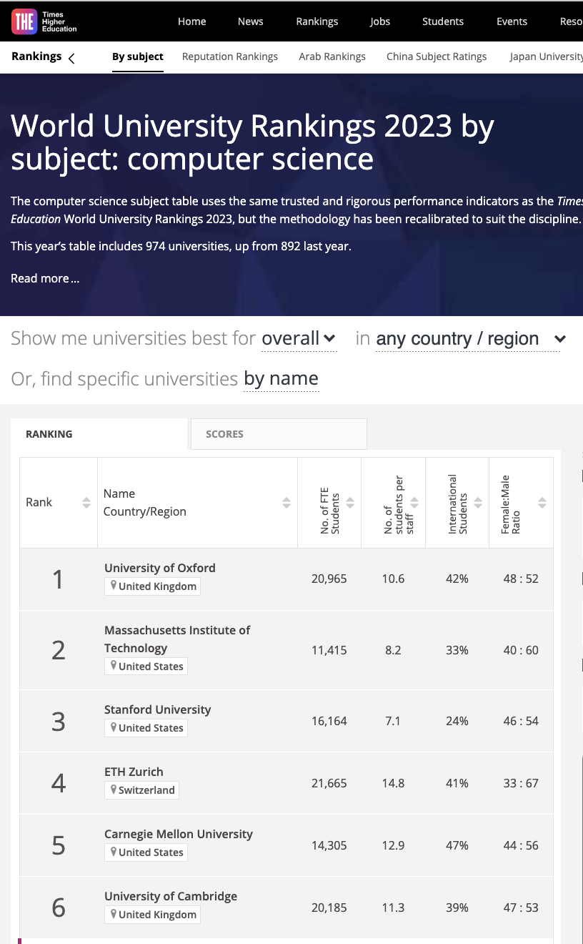
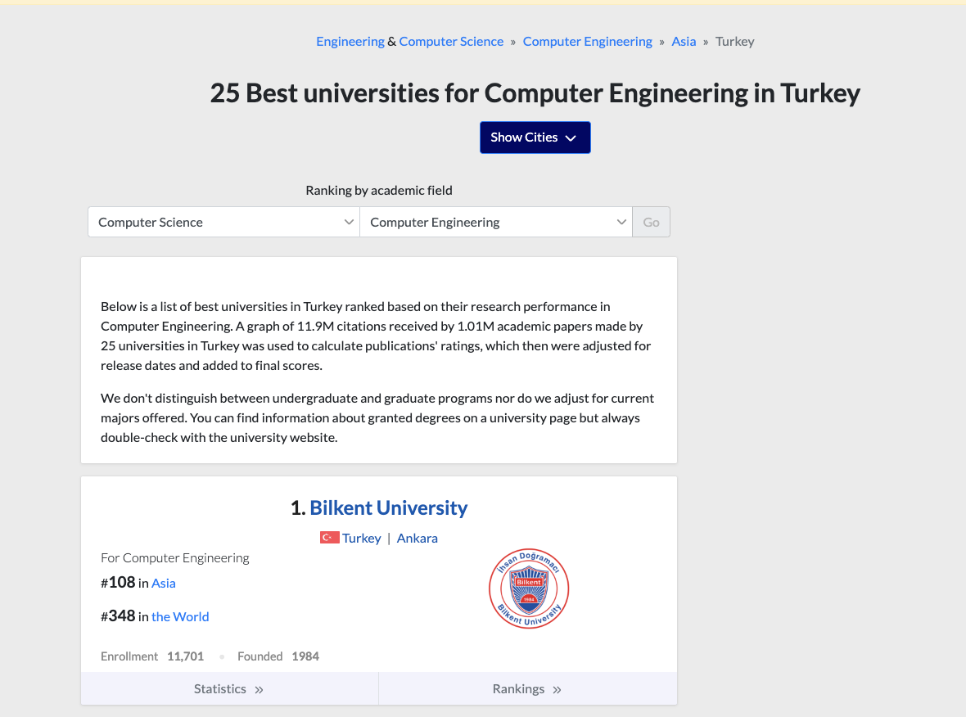


Top Universities
1 https://www.timeshighereducation.com/world-university-rankings/2023/subject-ranking/computer-science
2 https://edurank.org/cs/computer-engineering/tr/ 3 https://www.utp.edu.my/Pages/Home.aspx 4 https://www.iugaza.edu.ps/p29807/

Slide 5
Course Info
Lecture Times:
Section 201: Sunday & Tuesday: 12:30-14:00 Room: L217
Section 202: Sunday & Tuesday : 09:30-11:00 Room: L216
Office Hours: TBA (to be announced) .
Office Location: TBA.

Slide 6
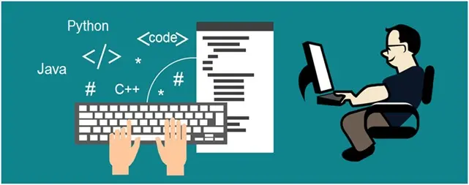
Programming
Programming is a process of designing and writing computer programs that make the workings of a computer more efficient.
It is a form of communication that uses symbols to represent instructions for making a machine do what you want.
Programming enables people to solve practical problems by breaking them down into a series of logical steps, known as algorithms or programs.
https://codedamn.com/news/programming/why-is-programming-important-2

Slide 7

Reasons to Learn Programing
https://flatironschool.com/blog/reasons-why-you-should-learn-computer-programming/

Slide 8
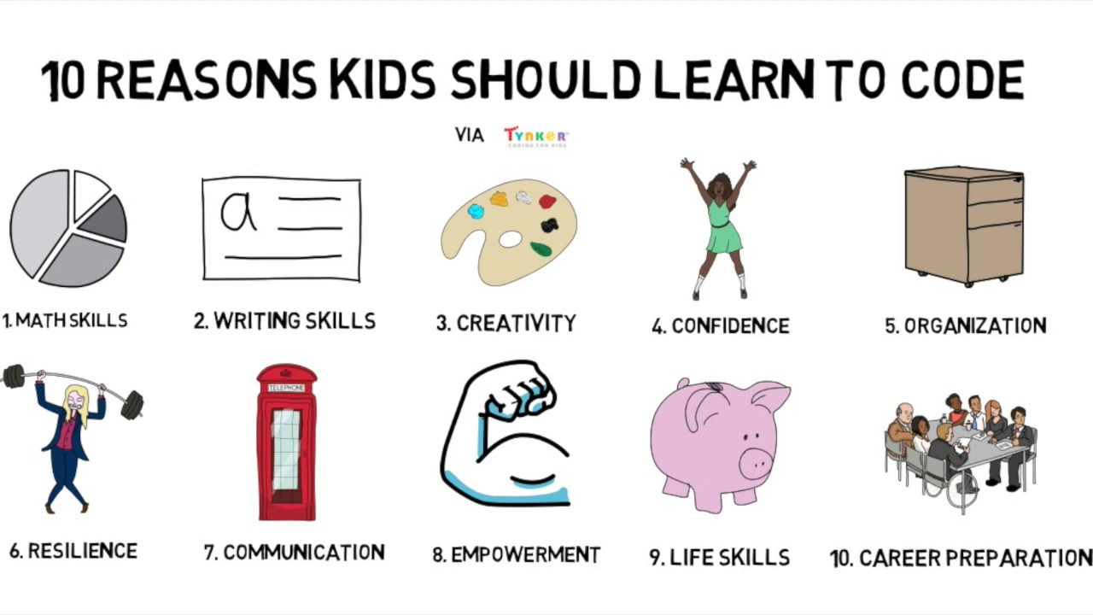


Reasons to Learn Programing
http://brianaspinall.com/10-reasons-kids-should-learn-to-code/

Slide 9

Java
Java is a widely used class-based, object-oriented programming language and software platform that runs on billions of devices, including notebook computers, mobile devices, gaming consoles, medical devices and many others.
When the language was invented in 1991, the primary goal was to be able to "write once, run anywhere (WORA)”.

Slide 10
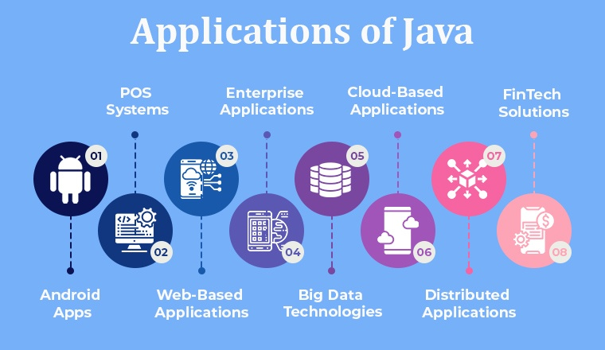
Java Applications
https://www.tatvasoft.com/outsourcing/2021/06/why-does-your-business-need-java-developers.html
Notes:
A point of sale (POS) is a place where a customer executes the payment for goods or services and where sales taxes may become payable.
Enterprise software, also known as enterprise application software, is computer software used to satisfy the needs of an organization rather than individual users. Such organizations include businesses, schools, interest-based user groups, clubs, charities, and governments.
Fintech is a portmanteau of the words “financial” and “technology”. It refers to any app, software, or technology that allows people or businesses to digitally access, manage, or gain insights into their finances or make financial transactions

Slide 11
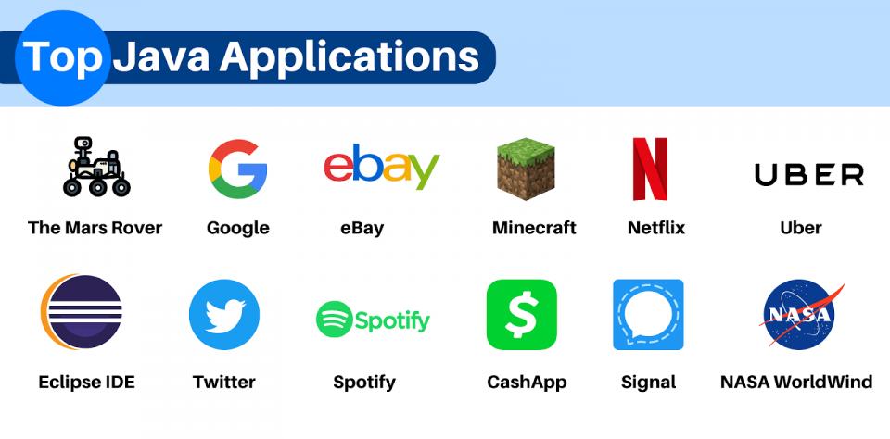
Top Java Apps
https://hackr.io/blog/java-application
Notes:
Mars rover is a motor vehicle designed to travel on the surface of Mars.

Slide 12
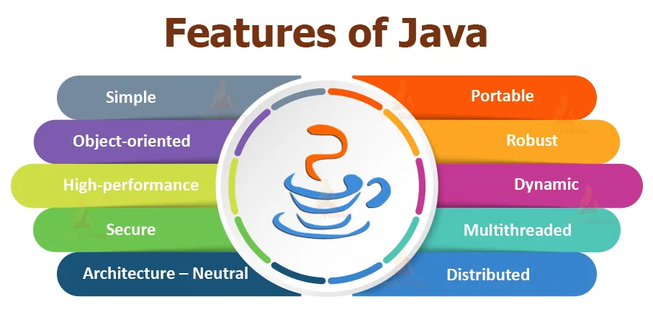
Why Java?
https://medium.com/nxtplus/why-java-daf4765abd24
Notes:
portability. Once you have written code for a Java program on a notebook computer, it is very easy to move the code to a mobile device.

Slide 13

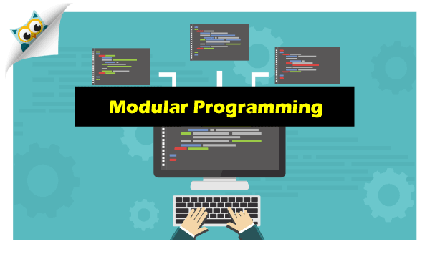
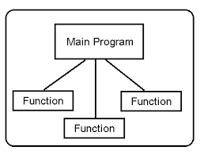
Course Description
This course covers the following topics:
Introduction to the fundamentals of programming and problem solving techniques.
Teaching the process of building a project in a modular fashion.

Slide 14
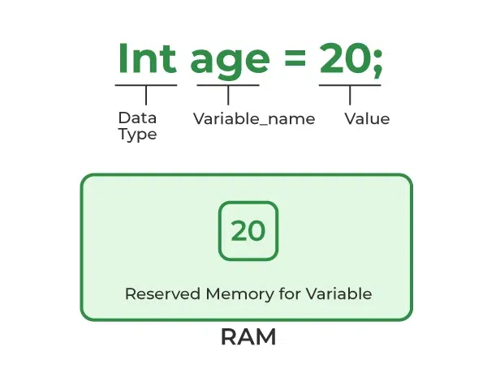
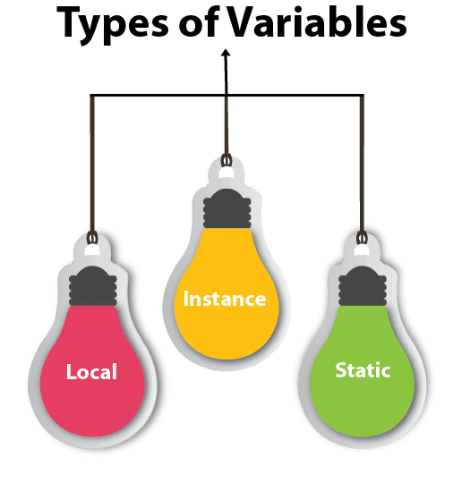
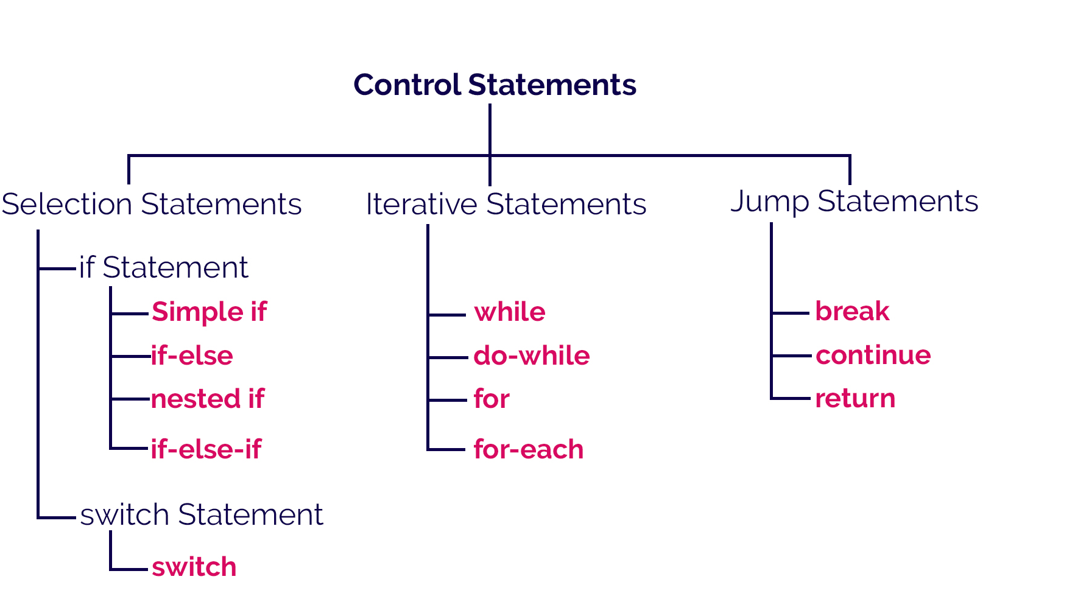
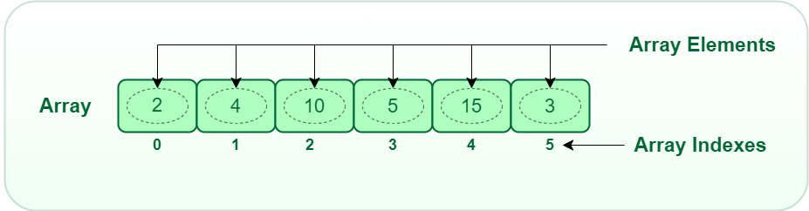
Course Description
This course covers the following topics:
Fundamentals of programming including
Variables.
Control statements.
Arrays.
.
https://www.javatpoint.com/java-variables
https://www.geeksforgeeks.org/what-is-array/
Notes:
A variable declared inside the body of the method is called local variable.
A variable declared inside the class but outside the body of the method, is called an instance variable. It is not declared as static. (e.g., inside main)
A variable that is declared as static is called a static variable. It cannot be local. You can create a single copy of the static variable and share it among all the instances of the class. Memory allocation for static variables happens only once when the class is loaded in the memory. (inside class outside main)

Slide 15
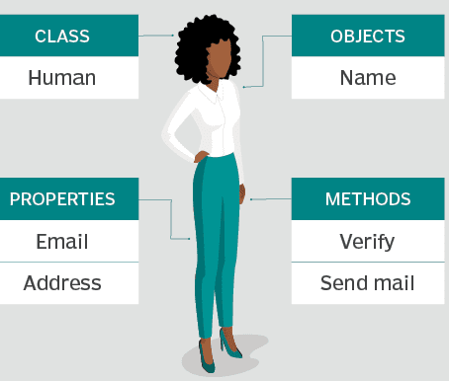
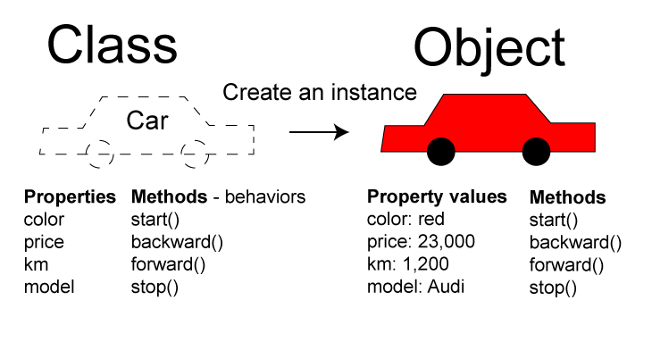
Course Description
This course covers the following topics:
Fundamentals of programming including
Object-oriented programming (OPP) in Java.
Principles of object oriented classes, and objects.
1 https://ambmfam.com/what-is-object-oriented-programming/
2 https://codersite.dev/understanding-oop-concepts/
Notes:
A class is like a plan or layout that helps to make things in a certain way. Classes are groups that include things with similar qualities,

Slide 16
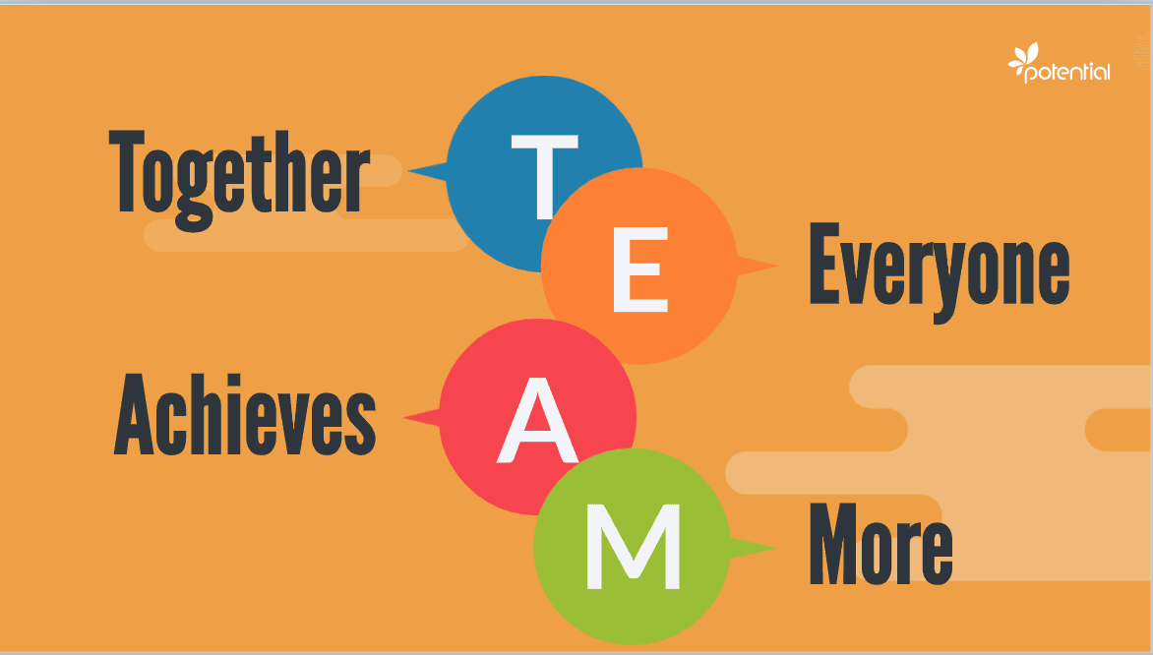



Course Objectives
Upon the completion of this course, students should be able to :
Master problem solving and logical thinking skills.
Develop simple algorithms by using conditional statements, arrays and loops.
Understand and use the basics of Object Oriented Programming (OOP).
Structure simple programming projects by using objects and classes.
Analyze a java application's components.
Practice how to work in a motivated, supportive, and well managed programming team environment.

Slide 17
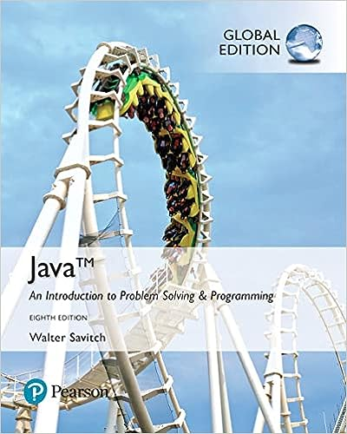
Main Textbook
Java: An Introduction to Problem Solving and Programming, 8th Edition, By Walter Savitch, Pearson (2017).

Slide 18
Course Schedule
Serial | Topic | Readings
1 | Introduction to Programming | CH1
2 | Introduction to Computer, Program, and Java
3 | Elementary Programming
4 | Fundamentals of Programing
5 | Primitive Data Types, Variables, constants, assignments | CH2
6 | Expressions and operators
7 | Conditional (selection) statements | CH3
8 | Mathematical Functions, characters and String
9 | Loops | CH4
10 | Methods | CH6
11 | Arrays | CH7
12 | Introduction to Classes and objects | CH5
13 | Defining Classes , Constructors, and Methods | CH5 & CH8
14 | Course Closing

Slide 19
Course Teaching Method
The class will be taught as a combination of:
Lectures.
Software presentations.
Group discussion.
Exercises and discussion of real-world coding examples.
Online learning using Moodle.
A project.

Slide 20
Course requirements
Include attendance of all lecturers, demonstrations and review of assignments given in previous classes. Excessive absences that exceed 25% of the lectures will be reported to the college administration.

Slide 21
Grading
Criterion | Percentage
Attendance, Assignments and Quizzes | 15%
Project | 25%
Midterm | 20%
Final exam | 40%
Total | 100%

Slide 22

Assignments and Quizzes
The assignments will be provided throughout the course.
An assignment at the end of each chapter.
Hand written answers are required.
Several pop quizzes throughout the course.

Slide 23

Do you have
any QUESTION?
Notes:
Do you have any Questions?

